Slide 1

Numpy Matrix

Slide 2
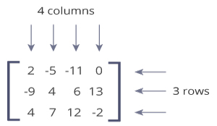
Matrix
A matrix is a two-dimensional data structure where numbers are arranged into rows and columns.
This matrix is a 3x4 (pronounced "three by four") matrix because it has 3 rows and 4 columns.

Slide 3

Python Matrix
Python doesn't have a built-in type for matrices. However, we can treat list of a list as a matrix.
A = [[1, 4, 5],
[-5, 8, 9]]
We can treat this list of a list as a matrix having 2 rows and 3 columns.

Slide 4
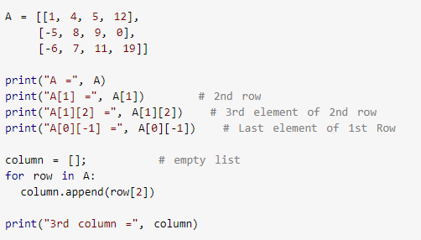
Nested List
Notes:
Answer:
A = [[1, 4, 5, 12], [-5, 8, 9, 0], [-6, 7, 11, 19]]
A[1] = [-5, 8, 9, 0]
A[1][2] = 9
A[0][-1] = 12
3rd column = [5, 9, 11]

Slide 5
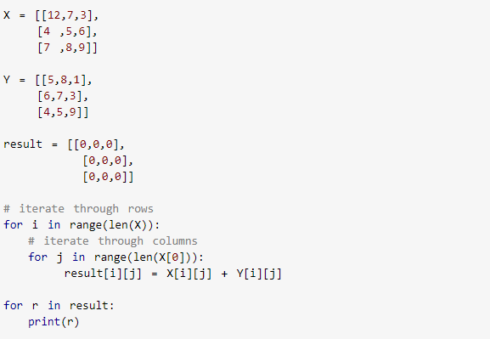
Add Two Matrix

Slide 6
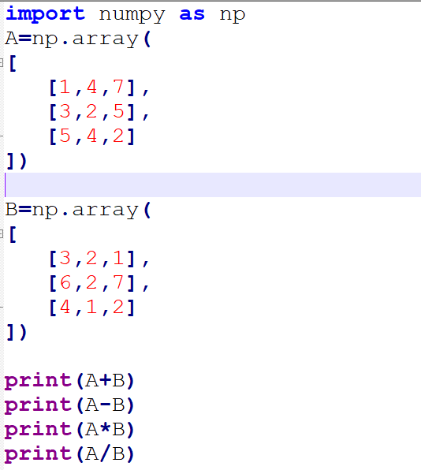
Numpy matrix addition

Slide 7
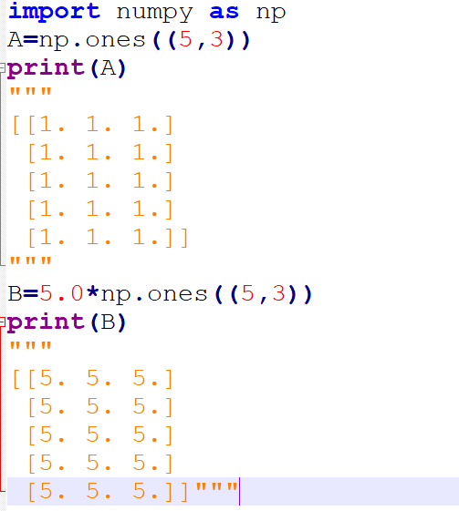
Matrix Methods

Slide 8
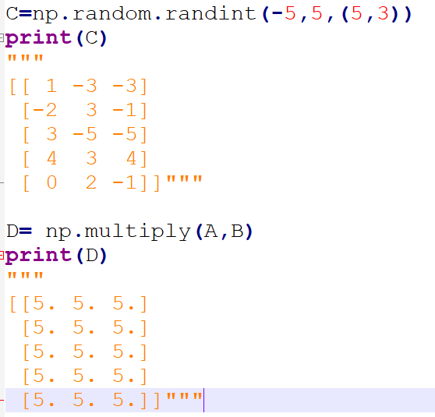
Cont..

Slide 9
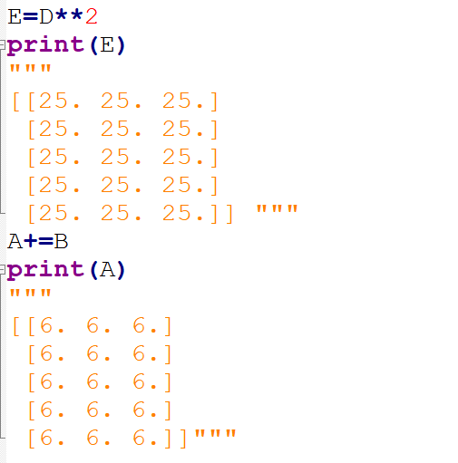
Cont..

Slide 10
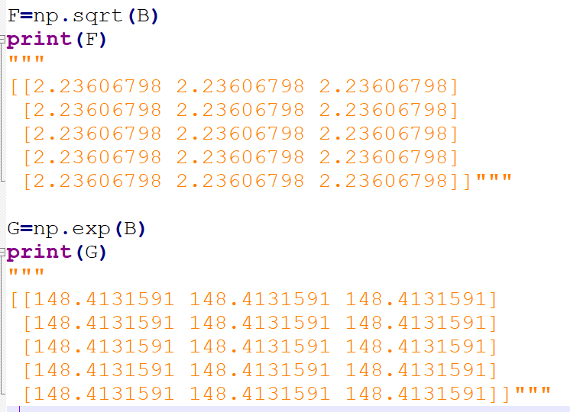
Cont..

Slide 11
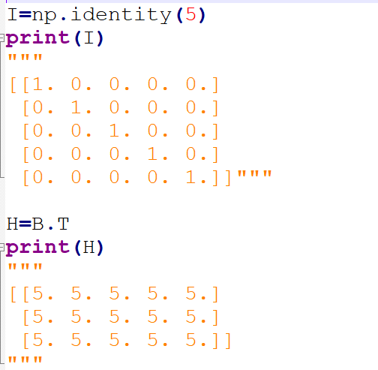
Cont..

Slide 12
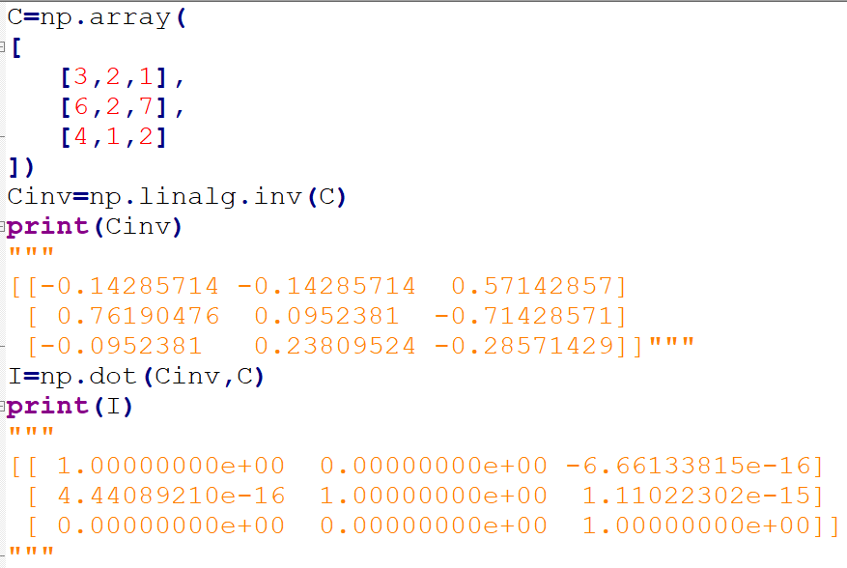
Cont..

Slide 13
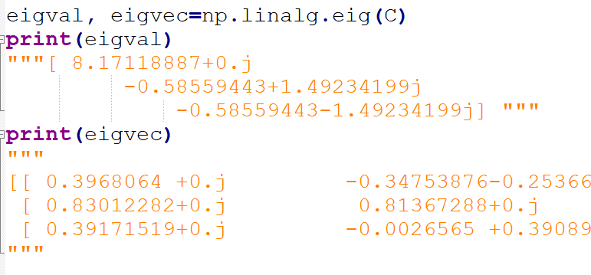
Cont..

Slide 14
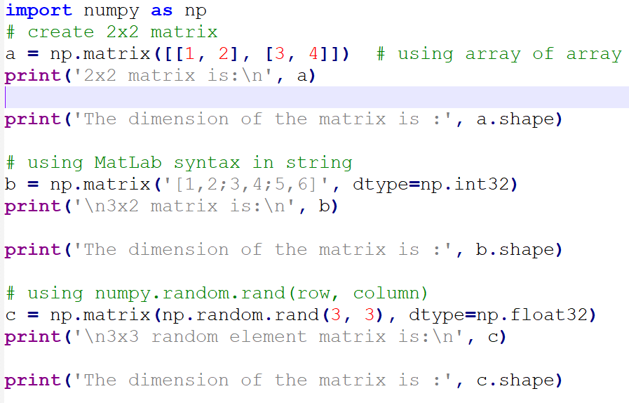
Using matrix method

Slide 15
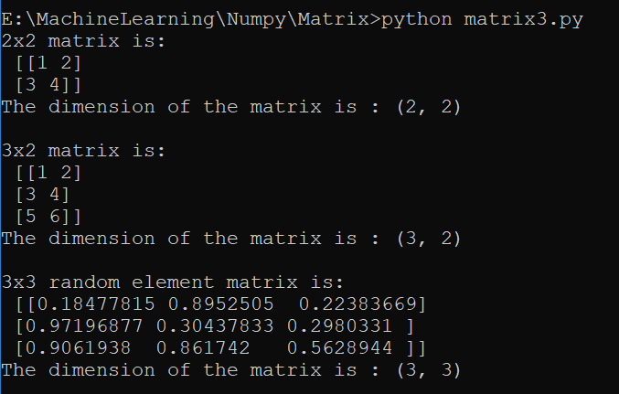
Ans..

Slide 16
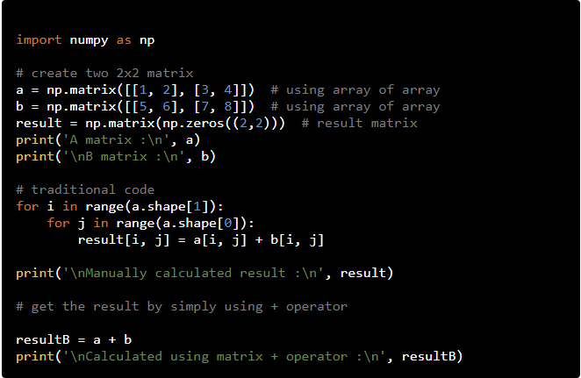
Matrix Addition

Slide 17
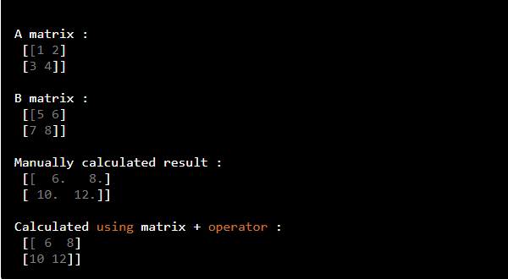
Ans..

Slide 18
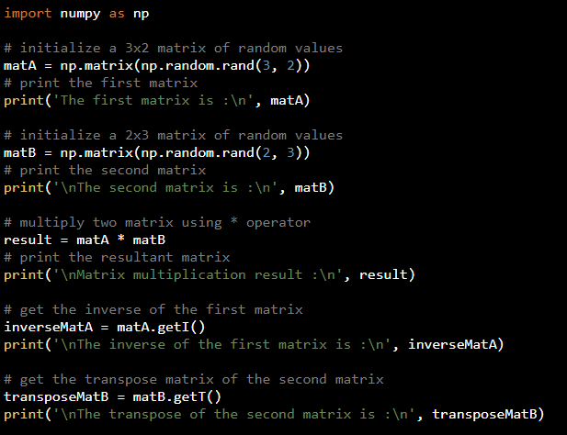
Matrix Multiplication, Inverse Matrix, Matrix Transpose

Slide 19
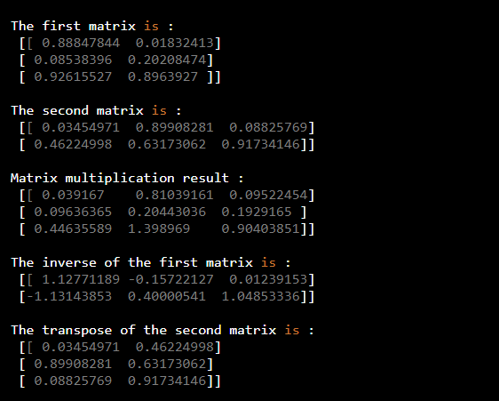
Answer

